Slide 1
WELCOME

Slide 2
Cross-Sell Prediction
PROJECT
Problem Statement:
Predict whether the policyholders (customers) from past year will also be interested in Vehicle Insurance provided by the company.

Slide 3
INFORMATION ABOUT COLUMNS(FEATURES) of train data
No. | FEATURES(COLUMNS) | DEFINATION
1 | id | Unique ID for the customer
2 | Gender | Gender of the customer
3 | Age | Age of the customer
4 | Driving_License | 0 : Customer does not have DL 1 : Customer already has DL
5 | Region_Code | Unique code for the region of the customer
6 | Previously_Insured | 1 : Customer already has Vehicle Insurance 0 : Customer doesn't have Vehicle Insurance
7 | Vehicle_Age | Age of the Vehicle
8 | Vehicle_Damage | 1 : Customer got his/her vehicle damaged in the past 0 : Customer didn't get his/her vehicle damaged in the past
9 | Annual_Premium | The amount customer needs to pay as premium in the year
10 | Policy_Sales_Channel | Anonymised Code for the channel of outreaching to the customer i.e. Different Agents, Over Mail, Over Phone, In Person, etc.
12 | Vintage | Number of Days, Customer has been associated with the company
13 | Response | 1 : Customer is interested, 0 : Customer is not interested
Rows of train data : 381109

Slide 4
Libraries :
NumPy : Used for working with arrays. It also has functions for working in
domain of linear algebra, fourier transform, and matrices.
Pandas : Analyze data. learning by reading. munging and preparation.
Scikit : Learn for machine learning. Built on NumPy, SciPy & matplotlib
this library contains a lot of efficient tools for machine learning
and statistical modeling including classification, regression,
clustering and dimensionality reduction.
Matplotlib : For plotting vast variety of graphs, starting from histograms to
line plots to heat plots.
SCIPY : used for solving mathematical, scientific, engineering, and technical
problems.
Seaborn : Python data visualization library based on matplotlib.

Slide 5
DATA CLEANING
unique feature : Train data having a unique feature " id " . so we dropped the " id "
feature.
NULL VALUES : Train data is not having any missing values
DATA TYPE CONVERSION : "Gender","Vehicle_Age","Vehicle_Damage" this three
features are having categorical (object) data types
that's why we converted categorical into
numeric(int/float) features with the help of LableEncoder

Slide 6
Model on Train data to check performance after the data cleaning
MODEL | CONFUSION MATRIX | ACCURACY | PRECISION | RECALL | F1-SCORE | REMARK
Logistic Regression | [[66240, 8853], [ 764, 365]] | 87.3829 | 0: 0.99 1: 0.04 | 0: 0.88 1: 0.32 | 0: 0.93 1: 0.07 | The confusion matrix is good. The accuracy is good. Precision, recall & f1-score shows high difference for 0 & 1. So it is not good algorithm.
Decision Tree | [[59884, 6356], [ 7120, 2862]] | 82.3200 | 0: 0.89 1: 0.31 | 0: 0.90 1: 0.29 | 0: 0.90 1: 0.30 | Confusion matrix is good. The accuracy is good but not that much. Precision, recall & f1-score shows high difference for 0 & 1. So it is not good algorithm.
Random Forest | [[64968, 8097], [ 2036, 1121]] | 86.7059 | 0: 0.97 1: 0.12 | 0: 0.89 1: 0.36 | 0: 0.93 1: 0.18 | Confusion matrix is good. The accuracy is good. Precision, recall & f1-score shows high difference for 0 & 1. So it is not good algorithm.
Adaboost | [[63618, 7769], [ 3386, 1449]] | 85.3651 | 0: 0.95 1: 0.16 | 0: 0.89 1: 0.30 | 0: 0.92 1: 0.21 | The confusion matrix is good. The accuracy is good but not that much. Precision, recall & f1-score shows high difference for 0 & 1. So it is not good algorithm.
Xgboost | [[66730, 8987], [ 274, 231]] | 87.8499 | 0: 1.00 1: 0.03 | 0: 0.88 1: 0.46 | 0: 0.94 1: 0.05 | The confusion matrix is good. The accuracy is good. Precision, recall & f1-score shows high difference for 0 & 1. So it is not good algorithm.
Naive Bayes | [[46398, 4665], [20606, 4553]] | 66.8455 | 0: 0.69 1: 0.49 | 0: 0.91 1: 0.18 | 0: 0.79 1: 0.26 | The confusion matrix is good. The accuracy is not good. Precision, recall & f1-score shows high difference for 0 & 1. So it is not good algorithm.
As we haven't found a good model yet so we will apply some techniques & do EDA.

Slide 7
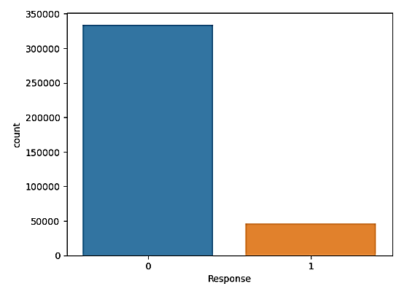
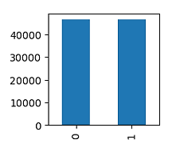
We will check the balance-imbalance condition
Count plot of target column " Response " :
The value count for 0 is 334399 and for 1 is 46710.
The train data having class-imbalance problem therefore we have to use class imbalance technique.
We use under-sampling here because the train data is highest data as it contain 381109 rows.
We use Near Miss under-sampling.
Bar plot of target column " Response " after the Near Miss under-sampling :
Now the class-imbalance problem resolved.
Count
Response

Slide 8
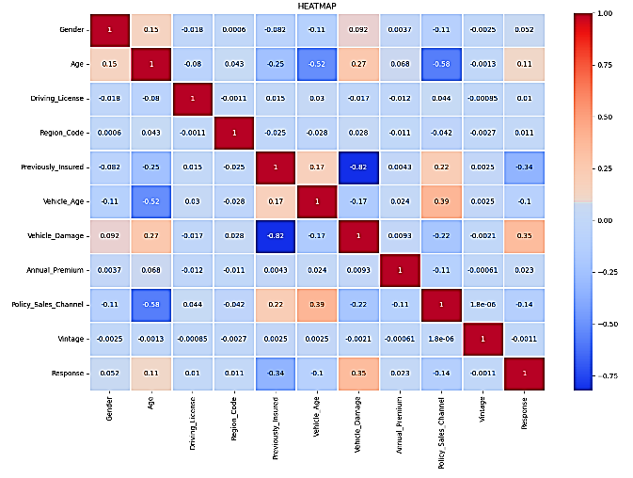
EXPLORATORY DATA ANALYSIS(EDA)
Data visualization : Heatmap

Slide 9
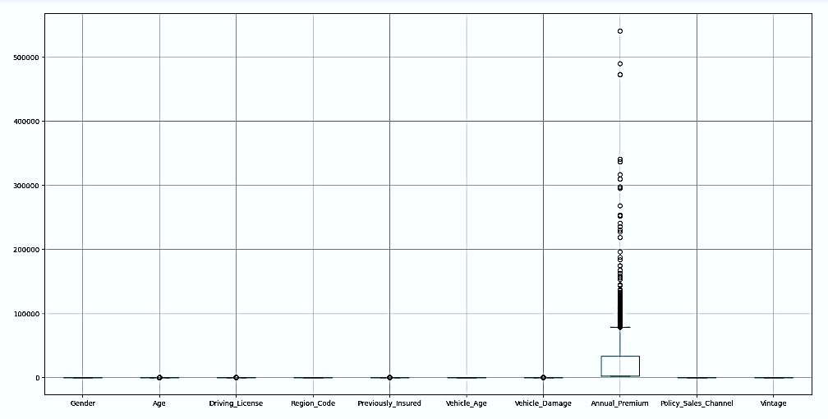
Outlier Treatment
EXPLORATORY DATA ANALYSIS(EDA) :
FIG. BOXPLOT
According to boxplot " Age ", "Driving_License" , " Previously_Insured "," Vehicle_Damage " & " Annual_Premium ", this five features having outliers. only "Annual_Premium" & " Age " column need outlier treatment because other are categorical features.

Slide 10
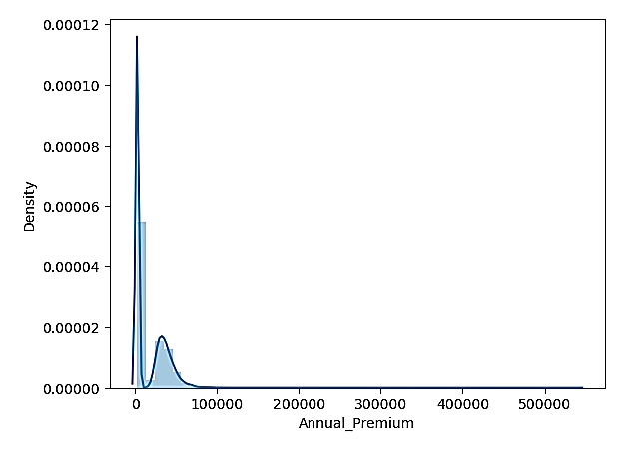
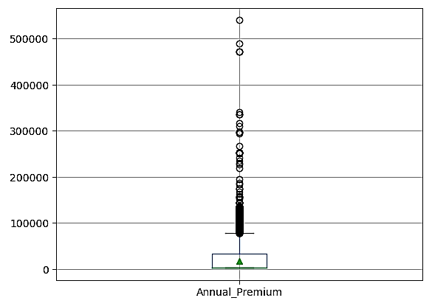
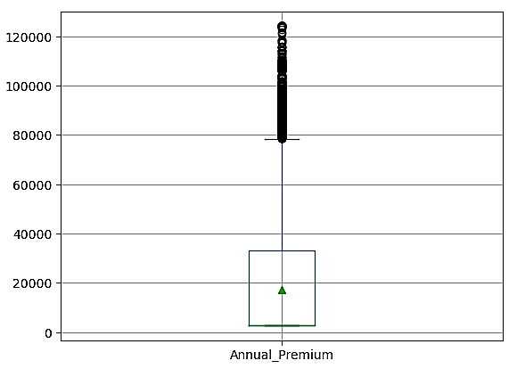
Annual_Premium
DISTPLOT
The distplot is skewed one therefore IQR(inter quartile range) method is suitable for treatment of outliers.
BEFORE THE OUTLIER TREATMENT :
AFTER THE OUTLIER TREATMENT :
BOXPLOT
BOXPLOT

Slide 11
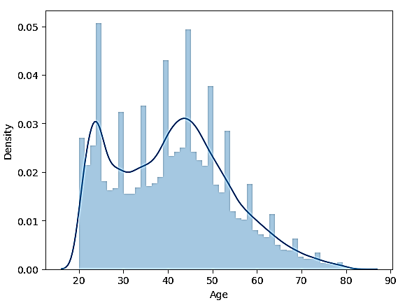
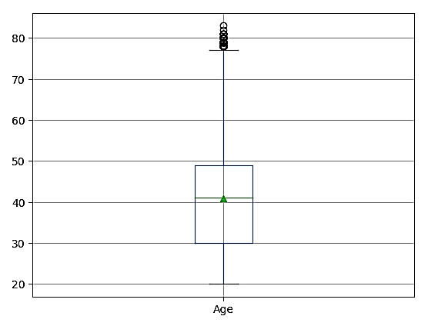
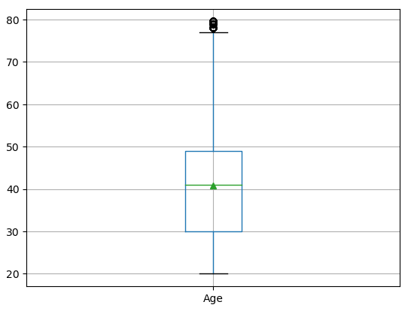
AGE
DISTPLOT
The distplot is normal distributed therefore using standard deviation we treat the outliers
BEFORE THE OUTLIER TREATMENT :
AFTER THE OUTLIER TREATMENT :
BOXPLOT
BOXPLOT

Slide 12
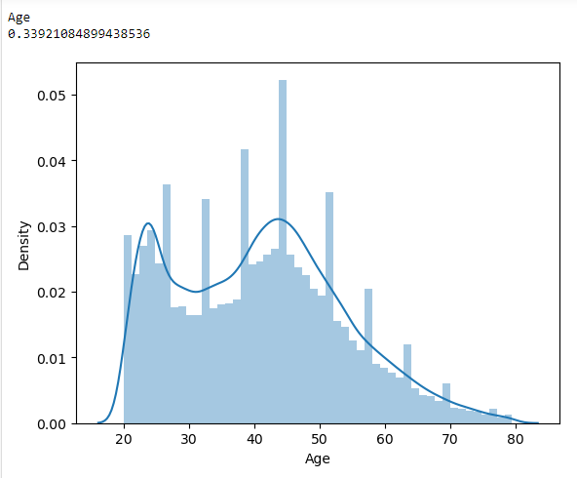
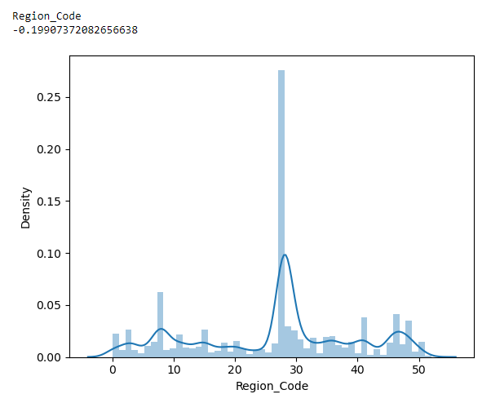
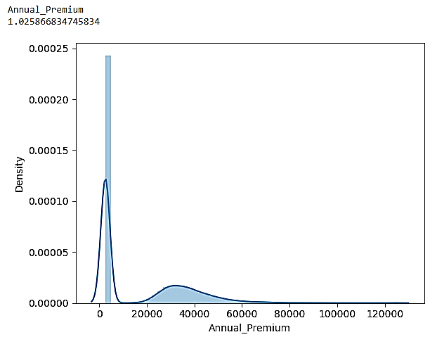
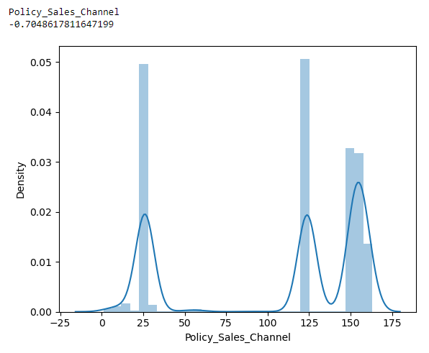
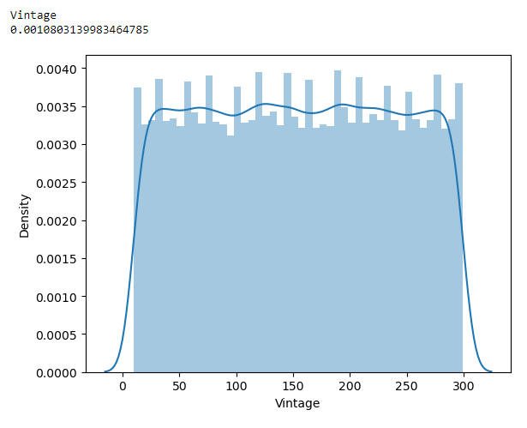
skewness
FEATURES | SKEWNESS
Age | 0.339216
Region_Code | -0.199077
Annual_Premium | 1.025883
Policy_Sales_Channel | -0.704873
Vintage | 0.001080
For the "Annual_Premium" we have to treat skewness because it shows 1.025883 skewness and according rule the skewness must be in the range of -1 to 1.For the other features no need to treat skewness because the skewness is in the range of -1 to 1.
Using cube root we treat skewness of "Annual_Premium". Now skewness is 0.5199

Slide 13
Model on Train data to check performance after the class imbalance technique and EDA(outlier & skewness treatment
MODEL | CONFUSION MATRIX | ACCURACY | PRECISION | RECALL | F1-SCORE | REMARK
Logistic Regression | [[9392, 1716], [ 7, 7569]] | 90.7782 | 0: 1.00 1: 0.82 | 0: 0.85 1: 0.00 | 0: 0.92 1: 0.90 | The confusion matrix and accuracy are good. Precision for 0 is 1.00 & recall for 1 is 1.00 which is not good. So it is not good algorithm.
Decision Tree | [[8169, 1138], [1230, 8147]] | 87.3260 | 0: 0.87 1: 0.88 | 0: 0.88 1: 0.87 | 0: 0.87 1: 0.87 | The confusion matrix and accuracy are good. Precision, recall & f1-score are also good. So we can say that it is best algorithm .
Random Forest | [[8948, 1396], [ 451, 7889]] | 90.1145 | 0: 0.95 1: 0.85 | 0: 0.87 0: 0.95 | 0: 0.91 0: 0.90 | The confusion matrix is good. The accuracy is also good as compared to the Decision Tree having 87.32 accuracy. Precision, recall & f1-score are also good. So we can say that Random Forest is best algorithm.
Adaboost | [[7683, 984], [1716, 8301]] | 85.5491 | 0: 0.82 1: 0.89 | 0: 0.89 1: 0.83 | 0: 0.85 1: 0.86 | The confusion matrix is good. The accuracy is good but less than the accuracy of Random Forest. Precision, recall & f1-score are also good. As compared to Random Forest Adaboost is not best suited.
Xgboost | [[9280, 1558], [ 119, 7727]] | 91.0244 | 0: 0.99 1: 0.83 | 0: 0.86 1: 0.98 | 0: 0.92 1: 0.90 | The confusion matrix is good. The accuracy is good and more than the random forest. f1-score is good but precision for 0 is 0.99 which is not good. As compared to Random Forest Xgboost is not best suited.
Naive Bayes | [[7521, 2702], [1878, 6583]] | 75.4870 | 0: 0.80 1: 0.71 | 0: 0.74 1: 0.78 | 0: 0.77 1: 0.74 | The confusion matrix is good. The accuracy not that much good. precision, recall & precision are good. As compared to random forest Naive Bayes is not best suited.
So we can conclude that Random Forest is best suited for our model having accuracy 90.11

Slide 14
Feature selection technique
Recursive feature elimination(RFE)
No. | FEATURE SUPPORT | COLUMN
1 | True | Age
3 | True | Region_Code
6 | True | Vehicle_Damage
7 | True | Annual_Premium
9 | True | Vintage
0 | False | Gender
2 | False | Driving_License
4 | False | Previously_Insured
5 | False | Vehicle_Age
8 | False | Policy_Sales_Channel
According to feature selection technique we drop the unnecessary columns that are "Policy_Sales_Channel", "Driving_License", "Gender", "Previously_Insured", "Vehicle_Age"

Slide 15
Model on Train data to check performance after the feature selection technique
MODEL | CONFUSION MATRIX | ACCURACY | PRECISION | RECALL | F1-SCORE | REMARK
Logistic Regression | [[9397, 1713], [ 2, 7572]] | 90.8210 | 0: 1.00 1: 0.82 | 0: 0.85 1: 1.00 | 0: 0.92 1: 0.90 | The confusion matrix and accuracy are good. Precision for 0 is 1.00 & recall for 1 is 1.00 which is not good. So it is not good algorithm.
Decision Tree | [[8116, 1291], [1283, 7994]] | 86.2235 | 0: 0.86 1: 0.86 | 0: 0.86 1: 0.86 | 0: 0.86 1: 0.86 | The confusion matrix and accuracy are good. Precision, recall & f1-score are also good. So we can say that it is best algorithm .
Random Forest | [[8736, 1452], [ 663, 7833]] | 88.6801 | 0: 0.93 1: 0.84 | 0: 0.86 1: 0.92 | 0: 0.89 1: 0.88 | The confusion matrix is good. The accuracy is also good but less than Logistic Regression . Precision, recall & f1-score are also good.
Adaboost | [[8095, 1310], [1304, 7975]] | 86.0094 | 0: 0.86 1: 0.86 | 0: 0.86 1: 0.86 | 0: 0.86 1: 0.86 | The confusion matrix is good. The accuracy is also good but less than Logistic Regression . Precision, recall & f1-score are also good.
Xgboost | [[9356, 1682], [ 43, 7603]] | 90.7675 | 0: 1.00 1: 0.82 | 0: 0.85 1: 0.99 | 0: 0.92 1: 0.90 | The confusion matrix is good. The accuracy is also good but less than Logistic Regression . Precision, recall & f1-score are also good.
Naive Bayes | [[6521, 2509], [2878, 6776]] | 71.1678 | 0: 0.69 1: 0.73 | 0: 0.72 1: 0.70 | 0: 0.71 1: 0.72 | The confusion matrix is good. The accuracy good. Precision, recall & precision are good.as compared to Logistic Regression is not best suited .
So after feature selection we have best algorithm as Random Forest having accuracy 88.68

Slide 16
Conclusion
So after feature selection we have best algorithm as Random Forest having accuracy 88.68
But without feature selection we have best algorithm as Random Forest with accuracy 90.11
So we can conclude that the Feature Selection is not best suited for our model
So we can conclude that Random Forest is best suited for our model having accuracy 90.11 after the class imbalance technique & EDA (without feature selection).

Slide 17
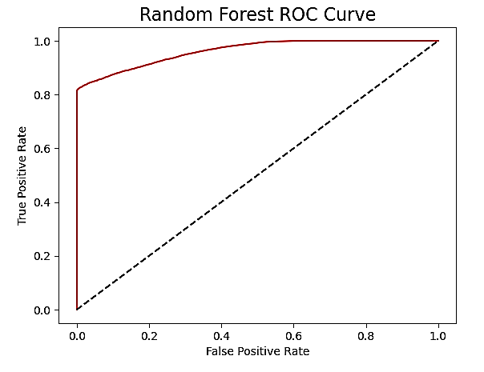
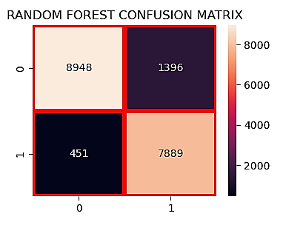
Random Forest
Confusion matrix :
AUC-ROC curve :
Classification Report :
ACCURACY | PRECISION | RECALL | F1-SCORE
90.1145 | 0: 0.95 1: 0.85 | 0: 0.87 0: 0.95 | 0: 0.91 0: 0.90

Slide 18
TEST DATA
The test data having 127037 rows and 11 columns .
We have to predict the target column " Response "
DATA CLEANING
unique feature : Test data having a unique feature " id " . so we dropped the " id "
feature.
NULL VALUES : Test data is not having any missing values
DATA TYPE CONVERSION : "Gender","Vehicle_Age","Vehicle_Damage" this three
features are having categorical (object) data types
that's why we converted categorical into
numeric(int/float) features with the help of LableEncoder

Slide 19
Prediction of target column " Response "
Obs. No. | id | Response
1 | 381110 | 1
2 | 381111 | 1
3 | 381112 | 1
4 | 381113 | 1
5 | 381114 | 1
6 | 381115 | 1
7 | 381116 | 1
8 | 381117 | 1
9 | 381118 | 0
10 | 381119 | 1
11 | 381120 | 0
12 | 381121 | 1
13 | 381122 | 1
14 | 381123 | 1
15 | 381124 | 0
16 | 381125 | 1
17 | 381126 | 1
So we fitted the Random Forest model on test data as it is best algorithm for our train data and created a sample submission file containing two features first one is unique ID for the customer " id " and second one is target column which is predicted " Response " which shows 0 for customer is not interested in insurance and 1 for customer is interested in vehicle insurance.
Sample of sample submission file

Slide 20
THANK YOU
ANY questions ?

